Slide 1


Spatial Temporal Math
Ruth Akintunde
Notes:
Name is
I’m a PhD… I work with the Game2Learn lab at North Carolina State University
My research focuses on detecting critical moments in students’ learning processes and tracing factors that contribute to knowledge gain especially in areas of STEM. Leveraging the power of deep learning architectures for multi-modal data streams including logs, facial expressions and eye tracking, my goal is to create advanced personalized learning tools for easy mastery of STEM subjects.
My most recent project involves improving learning on a curriculum integrated Math game called Spatial temporal Maths using Machine learning techniques.

Slide 2
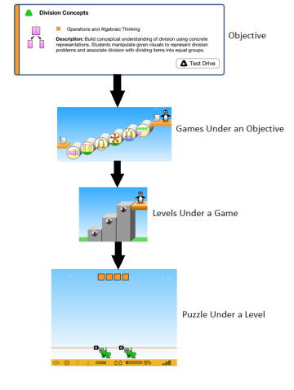

Spatial Temporal Math (ST MATH)
Notes:
ST Math is a curriculum-integrated educational math game that
acts as a year-long supplemental program to the existing math curriculum in elementary classrooms.
The game is designed to enhance students’ K-12 math skills through spatial-visual representations and informative feedback.
ST Math content is divided by grade- level and aligned to relevant Common Core or other state standards.
ST Math games, levels, and puzzles are nested within objectives, i.e., broader mathematical concepts.
Each objective contains a number of games, the gameplay under an objective varies but concerns the same content inside an objective. The games usually have between 3 to 5 levels each, and the gameplay across levels is similar but increases in difficulty. There are usually between 6 and 8 puzzles per level. The puzzles are either randomly generated using a template or randomly selected from pre-designed puzzles depending on the level.
Our most recent study analyzed data collected from 2017 ST Math gameplay by 3rd graders in 5 US districts during the 2017-2018 school year.

Slide 3
ST MATH - Motivation
Many adults have been traumatized by mathematics and one way to alleviate this is by introducing math games and puzzles to children as early as kindergarten [Harrington, 2016].
However, a math game with a curriculum sequence that does not teach math skills in a hierarchical manner is counterproductive.
Notes:
An article by Harrington in 2016, shows that many adults have been traumatized by mathematics and one way to alleviate this is by introducing math games and puzzles to children as early as kindergarten. However, a math game with a curriculum sequence that does not teach math skills in a hierarchical manner is counterproductive.

Slide 4
ST MATH - Curriculum Sequencing
How can we use data to infer an efficient curriculum sequence for ST Math?
Notes:
This led us to investigate what makes an efficient curriculum sequence for this Math Game called ST Math

Slide 5
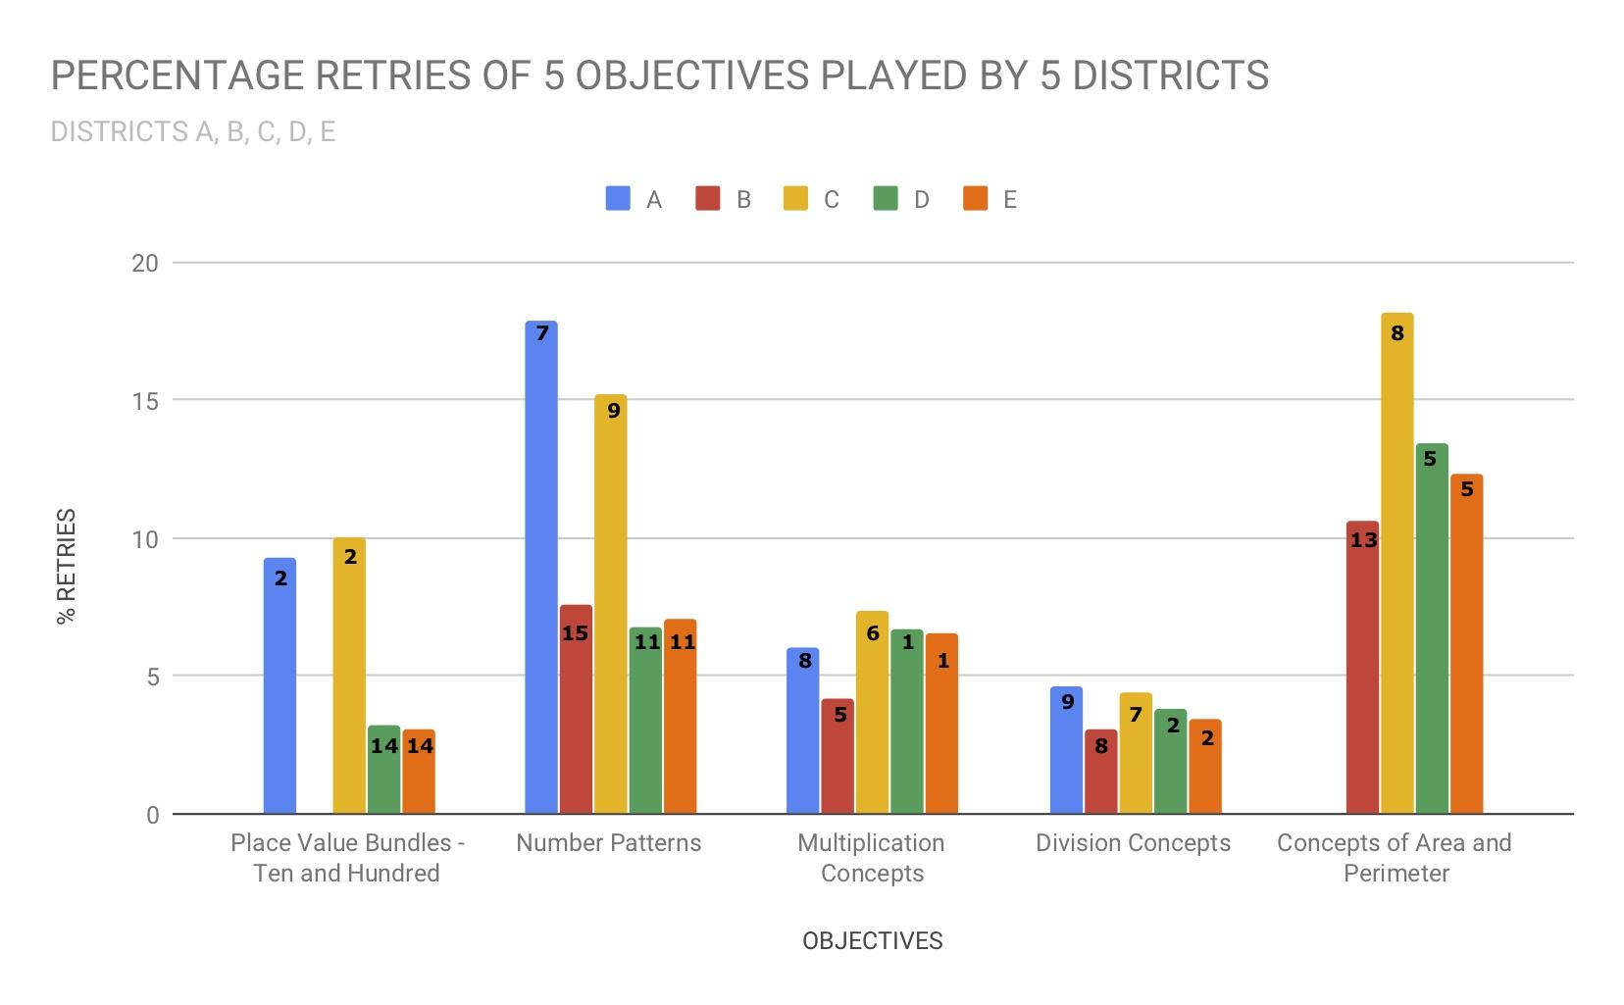
ST MATH - Retries
The number in each bar represents the position of each of the 5 objectives in the curriculum of each district.
Note: District B did not play “Place Value Bundles, Tens and Hundreds" and district A did not play “Concepts of Area and Perimeter."
Notes:
The Figure presented shows the sequence with which 5 districts played 5 ST Math objectives.
Retries are Level attempts other than the first attempt, that occur before the student passes the level
Retries are Different from replays in ST Math
Replays on a level are all attempts that occur after the level is passed
Since Many retries indicate a lack of understanding
Therefore, Reduction in retries indicates a reduction in the difficulty of objectives
The number in each bar represents the position of each of the 5 objectives in the curriculum of each district.
Note: District B did not play “Place Value Bundles, Tens and Hundreds" and district A did not play “Concepts of Area and Perimeter."

Slide 6
5 US Districts Play 5 Objectives
The number in each bar represents the position of each of the 5 objectives in the curriculum of each district.
Note: District B did not play “Place Value Bundles, Tens and Hundreds" and district A did not play “Concepts of Area and Perimeter."
Notes:
From analyzing these 5 objectives, we noticed an important pattern: that the rise and fall in number of retries needed before passing some objectives co-occur with the position of such objectives in the curriculum sequence. The objectives we analyzed fell into 3 groups.

Slide 7
Data Informed Sequences(1)
Observations | Suggestions
Group 1: Objectives that are difficult (i.e. have a high number of retries) or easy (i.e. have a low number of retries) depending on their position in the curriculum sequence. From the plot, we can see that two objectives namely "Place Value Bundles, Tens and Hundreds" and “Number Patterns” fall into the first group because their percentage retries dropped when played later in the sequence. | We replicated a unique method introduced by Liu et al. in 2017. This is a novel data-informed method to determine pairwise orderings for objectives in the curricular sequence. Districts that already followed our suggested order recorded a reduced number of retries within Group 1 objectives.
Notes:
Group 1: Objectives that are difficult (i.e. have a high number of retries) or easy (i.e. have a low number of retries) depending on their position in the curriculum sequence.

Slide 8
5 US Districts Play 5 Objectives
The number in each bar represents the position of each of the 5 objectives in the curriculum of each district.
Note: District B did not play “Place Value Bundles, Tens and Hundreds" and district A did not play “Concepts of Area and Perimeter."
Notes:
We replicated the 2017 study by Liu et al. which introduced a novel data-informed method to determine pairwise orderings for objectives in the curricular sequence.
We implemented this study on 5 US districts and suggested partial ordering of group 1 objectives which we reported in our paper published in 2019.
Districts that already followed our suggested order recorded a reduced number of retries within Group 1 objectives.

Slide 9
Data Informed Sequences(2)
Observations | Suggestions
Group 2: Objectives that always have a low number of retries no matter their position in the sequence. | These objectives are already well placed. So their current order should be maintained. Some of these objectives could be played at the beginning of the sequence. Since they are intuitive objectives, playing them first could help students become more familiar with the game environment.
Notes:
Group 2: Objectives that always have a low number of retries no matter their position in the sequence.

Slide 10
5 US Districts Play 5 Objectives
The number in each bar represents the position of each of the 5 objectives in the curriculum of each district.
Note: District B did not play “Place Value Bundles, Tens and Hundreds" and district A did not play “Concepts of Area and Perimeter."
Notes:
From the plot above, "Multiplication Concepts" and "Division Concepts" fall into group 2 because they are easy no matter the order they were played.
These objectives are already well placed. So their current order should be maintained. Some of these objectives could be played at the beginning of the sequence. Because they are intuitive objectives, playing them first could help students become more familiar with the game environment.

Slide 11
Data Informed Sequences(3)
Observations | Suggestions
Group 3: Objectives that always have a high number of retries, no matter their position in the sequence. “Concepts of Area and Perimeter” falls into this group. We discovered some game mechanic reasons for this, such as a potential lack of intuitiveness of the game. | We suggest that these objectives should be played at the end of the sequence. Students may need some form of guidance in playing higher levels of these objectives. It may be beneficial to redesign this game to make it more achievable, or build some prerequisite levels that assist students in relating perimeter and area.
Notes:
Group 3: Objectives that always have a high number of retries, no matter their position in the sequence.
“Concepts of Area and Perimeter” falls into this group.

Slide 12
5 US Districts Play 5 Objectives
The number in each bar represents the position of each of the 5 objectives in the curriculum of each district.
Note: District B did not play “Place Value Bundles, Tens and Hundreds" and district A did not play “Concepts of Area and Perimeter."
Notes:
We discovered some game mechanic reasons for this, such as a potential lack of intuitiveness of the game.
Although the tasks in “Concepts of Area and Perimeter” require students to apply to their knowledge of addition and multiplication, districts with students that had performed well in “Multiplication Concepts" and “Addition and Subtraction with Regrouping" in the past had a hard time with this objective.
We suggest that these objectives should be played at the end of the sequence. Students may need some form of guidance in playing higher levels of these objectives. Although we have no definitive evidence, such as that from clinical interviews, as to why students are struggling with this game, our results suggest that it may be beneficial to redesign this game to make it more achievable, or build some prerequisite levels that assist students in relating perimeter and area.

Slide 13
Other Research Questions
What is the best class format that ensure better team work and better performances?
What is an optimal game session length?
How can we detect Wheel Spinning?

Slide 14
Thanks!
Ruth Akintunde
rookoilu@ncsu.edu

